Slide 1
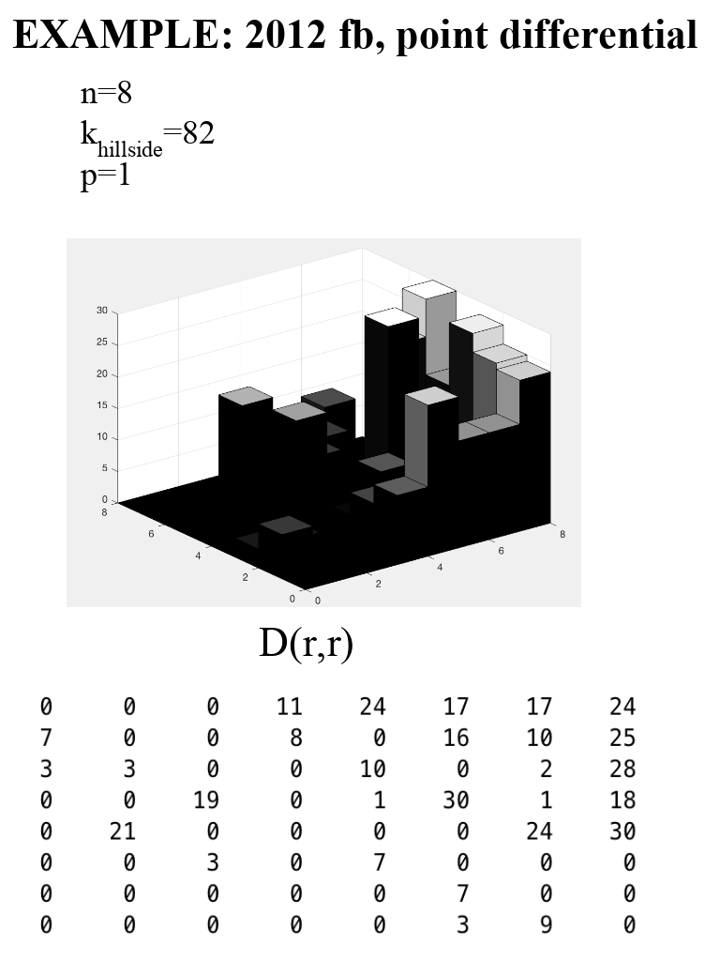
Amy – Hillside 1

Slide 2
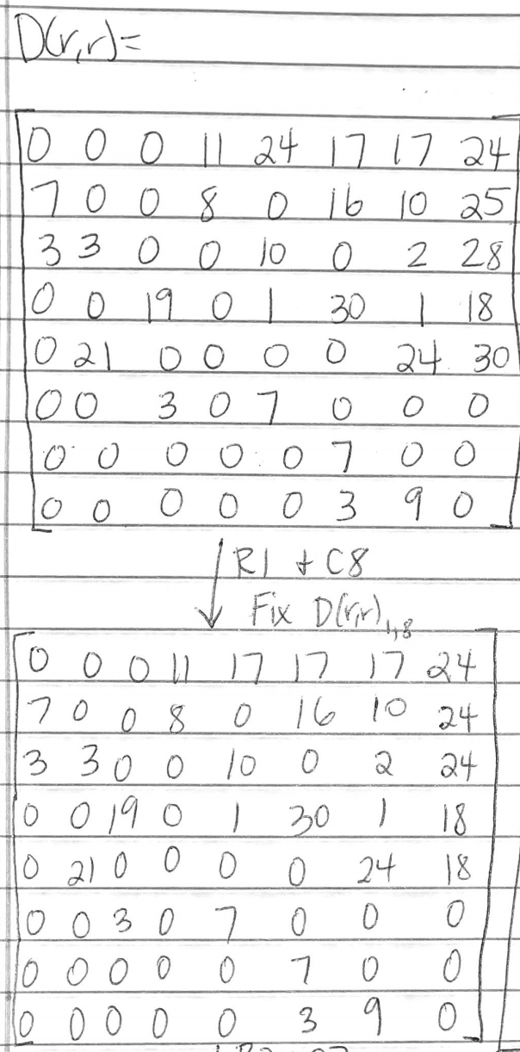

Slide 3
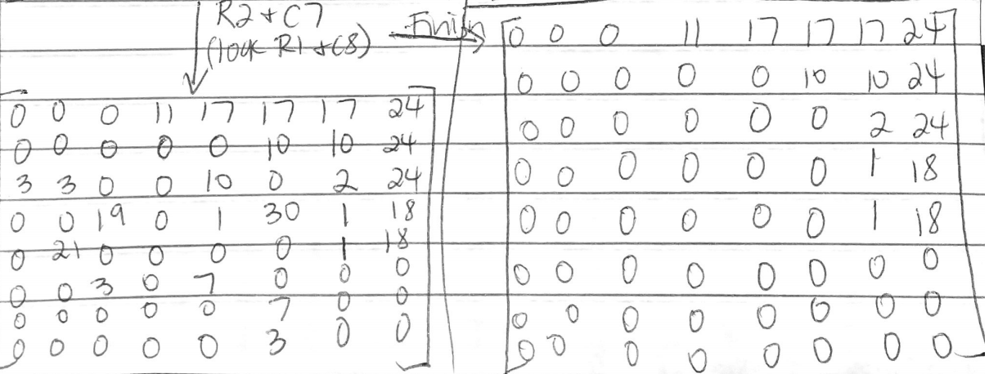

Slide 4
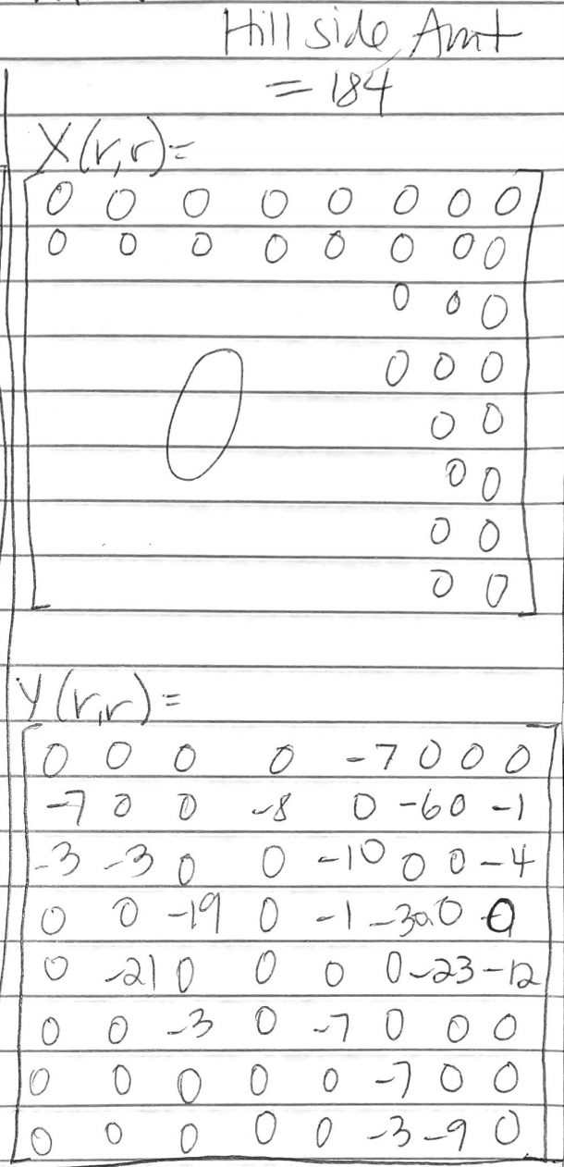

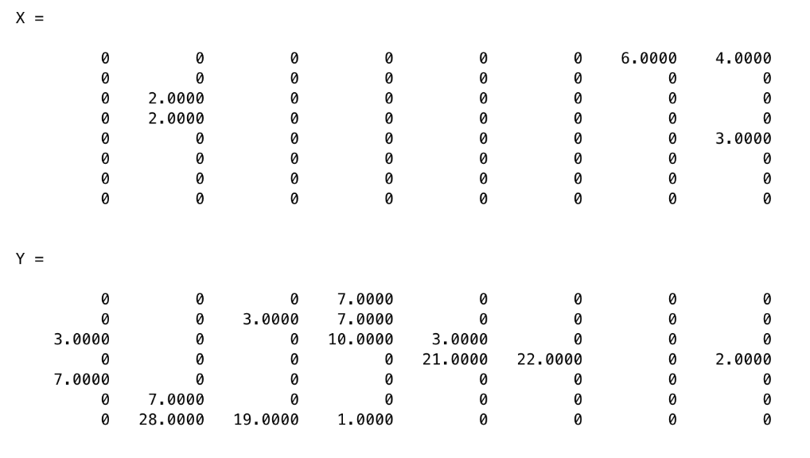

Slide 5
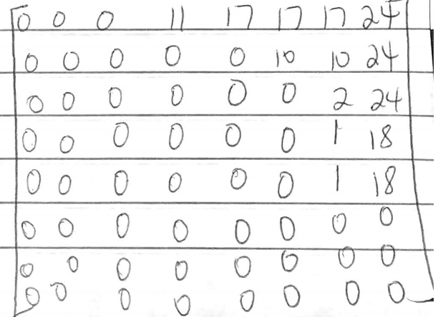
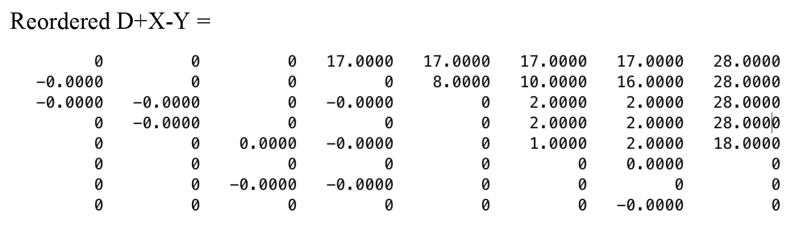

Slide 6
Questions
Will D-Y give you the same r?
Would it be better to add to X to make D(r,r)_{1,n} = max[D(r,r)]? Where better = lower X+Y?

